Slide 1


Generalization in ML: Bias-Variance Tradeoff, Validation and Model Performance
Dr. Nwe Nwe Htay Win
Professor
Parami University

Slide 2
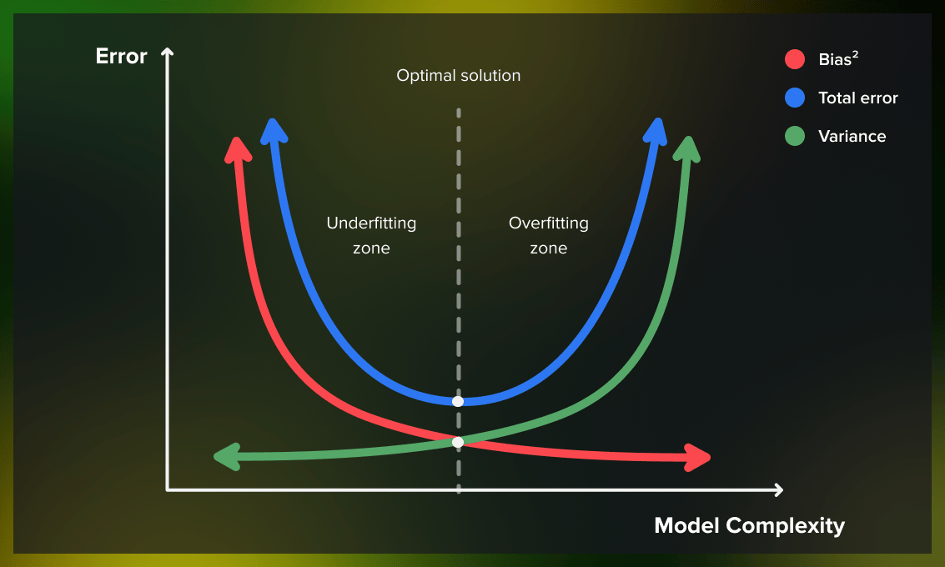
Overfitting & Underfitting
Overfitting
Overfitting occurs when a model learns the training data too well.
Instead of finding the general pattern, it memorizes the "noise" (random fluctuations and specific details) that only exist in that specific dataset.
Training Error: Extremely low (near 0%).
Test/Validation Error: Very high.
Underfitting
Underfitting occurs when a model is too simple to capture the underlying pattern of the data. It makes strong, incorrect assumptions about the data.
Training Error: High.
Test/Validation Error: High.

Slide 3
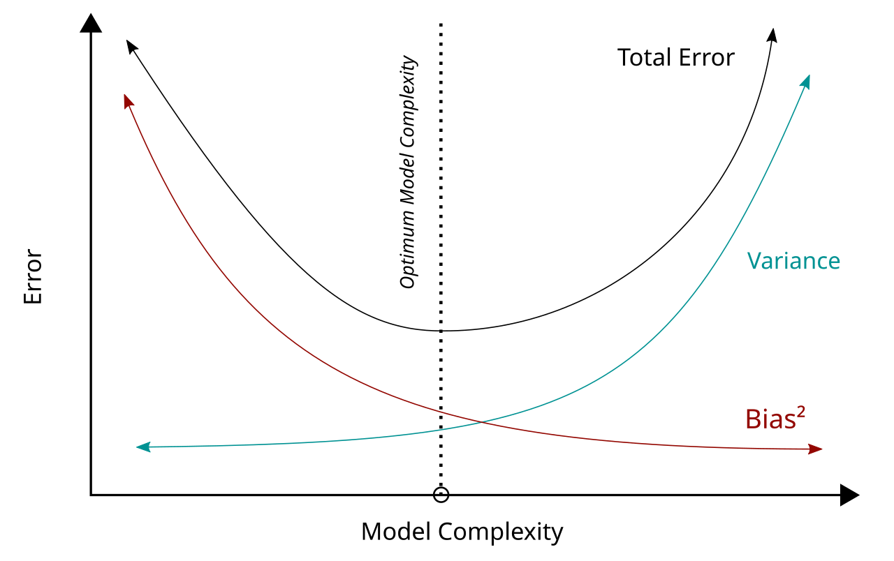
Bias – Variance Tradeoff
In machine learning (ML) and artificial intelligence (AI), bias-variance tradeoff is a concept that governs the performance of a predictive machine learning model and a fundamental tenant in data science.
The goal of Machine Learning is to perform well on unseen data, not just the data used for training.
Models often fail because they are either too simple or too complex.
A data/diagram showing the relationship between Training Error and Testing Error.
Bias and variance represent two sources of prediction error.
Bias measures how far off predictions are from the true values due to overly simplistic assumptions; variance, however, captures how much predictions fluctuate based on different training data.

Slide 4
Bias
Variance
Bias measures how far off, on average, a model’s predictions are from the ground truth values.
High-bias models tend to make strong assumptions about the form of the data and cause underfitting.
An overly simplistic model tends to have high bias and low variance—a model like this tends to have high training errors and high prediction errors.
Variance measures how much a model’s predictions change with different training datasets.
High-variance models are sensitive to noise in the training data and cause overfitting.
A model with complex architecture and more parameters tends to have high variance and low bias.
Ref: https://www.ibm.com/think/topics/bias-variance-tradeoff

Slide 5
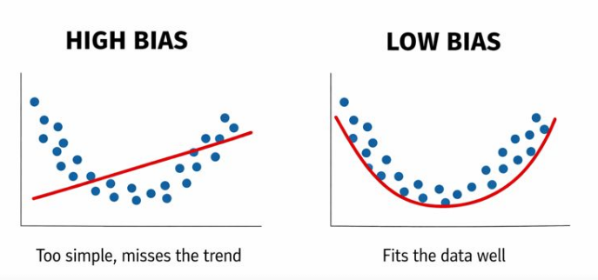
Bias
A high-bias model is too simple. It does not learn the real pattern in the data.
It means:
Performs badly on training data
Performs badly on test data
The model is underfitting
Common Causes:
Using a linear model for non-linear data.
Insufficient training time or features.
How to Prevent Underfitting (High Bias)
Increase Model Complexity: Use more layers in a neural network or higher-degree polynomials.
Feature Engineering: Add more relevant features or transform existing ones.
Decrease Regularization: If you are using techniques like Lasso or Ridge, reduce the penalty.
Train Longer: Ensure the algorithm has enough iterations to converge.

Slide 6
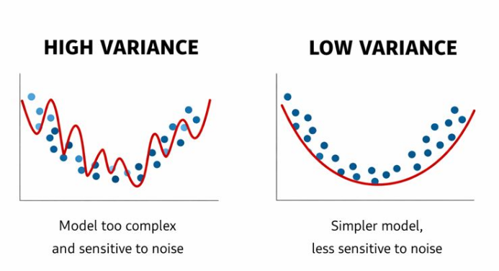
Variance
A high-variance model is too complex. It learns the training data too well, including the noise and random fluctuations.
It means:
Performs too well on training data but performs badly on unseen data.
The model is overfitting.
Common causes:
The model is too complex (too many parameters and) for the amount of data available.
The training data contains too much noise or irrelevant “garbage” info.
How to prevent overfitting (High variance)
Regularization: Use L1 (Lasso), L2 (Ridge) to penalize overaly large weights.
Cross-validation: Use Techniques like K-Fold to ensure the model generalizes.
Simplify the model: Reduce the number of features or parameters.

Slide 7
Bias and Variance Trade-off
Model Type | Bias | Variance | Result
Too simple | High | Low | Underfitting
Balanced | Medium | Medium | Best performance
Too complex | Low | High | Overfitting
Notes:
Bias = Too simple → doesn’t learn enough → underfitting Variance = Too complex → learns too much → overfitting

Slide 8
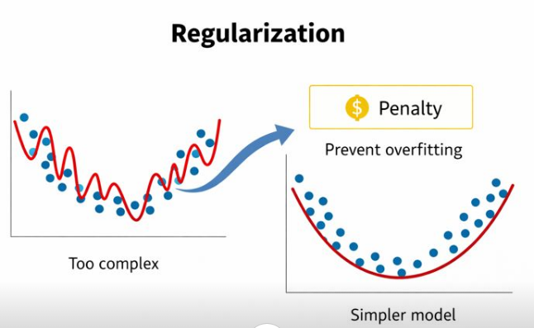
Regularization
Regularization is a technique used to prevent overfitting. It helps the model stay simple and generalize better to new data.
Regularization means adding a small penalty to the model so it doesn’t become too complex.
Regularization helps the model:
Focus on important features
Ignore noise
Stay smooth and stable

Slide 9
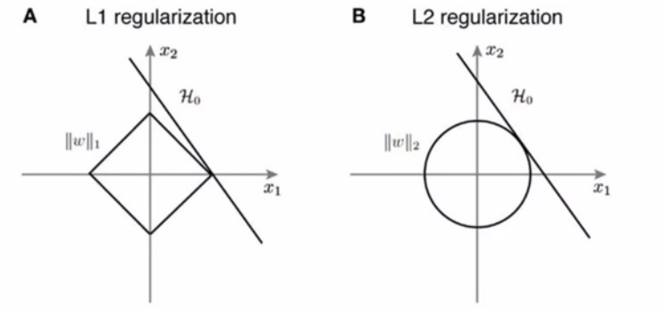
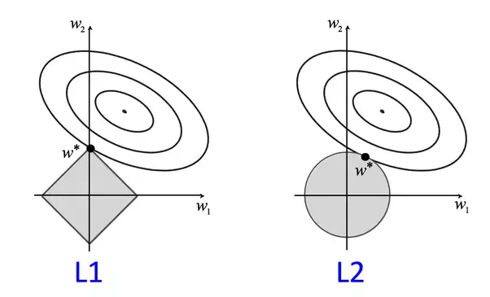
Types of Regularization (L1 and L2)
L1 Regularization (Lasso)
Adds the absolute value of weights as a penalty
Can make some weights exactly zero
Good for feature selection
L1 removes unimportant features.
L2 Regularization (Ridge / Weight Decay)
Adds the square of weights as a penalty
Makes weights small but not zero
Makes the model smooth and stable
L2 reduces the strength of all features.

Slide 10
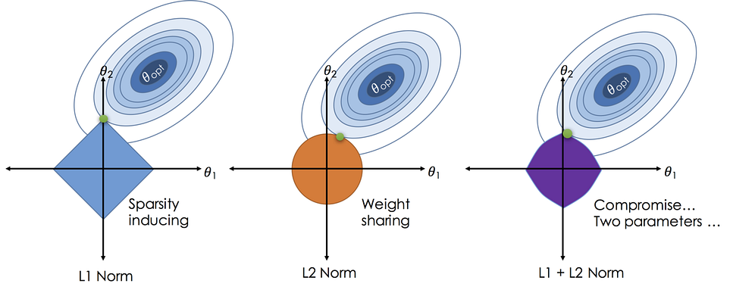
General Form
The general form of the loss function becomes:
Loss=Original Loss+λ⋅Penalty Term
λ is the regularization strength (higher = stronger regularization)
Penalty term depends on L1 or L2

Slide 11
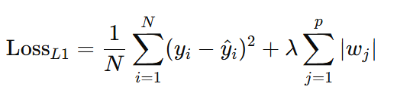
L1 Regularization (Lasso) Mathematical Formulation
L1 regularization, also known as Lasso (Least Absolute Shrinkage and Selection Operator), adds a penalty equal to the absolute value of the magnitude of coefficients.
The objective function for L1 regularization can be written as:
where:
yi​ is the actual output.
yi(cap)​ is the input feature.
wj​ are the weights of feature j
λ is the regularization parameter (hyperparameter) controlling the amount of regularization.

Slide 12
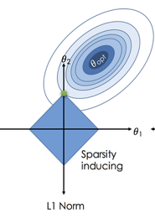
Key Characteristics of L1
Sparse Solutions: L1 regularization tends to produce sparse models, meaning many coefficients are exactly zero, leading to feature selection.
Feature Selection: It is beneficial when we have a large number of features, as it can automatically select the most relevant ones.
Pros:
Can shrink some weights to zero, effectively performing feature selection.
Good for high-dimensional data (many features, some irrelevant).
Can simplify the model, making it easier to interpret.
Cons:
If features are highly correlated, L1 may pick one randomly and ignore the rest.
Can be unstable when features are very similar or small sample size.
Doesn’t handle multicollinearity well.
L1 constraint: ∣w₁∣+∣w₂∣≤t
This is a diamond in 2D (because the sum of absolute values forms straight edges).

Slide 13
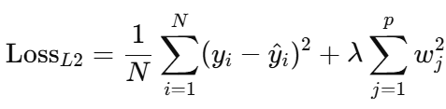
L2 Regularization (Ridge) Mathematical Formulation
L2 regularization, also known as Ridge regression, adds a penalty equal to the square of the magnitude of coefficients.
The objective function for L2 regularization can be written as:
L2 shrinks weights, but does not make them exactly zero.
It is used when:
All features are important
You want to reduce variance (overfitting)
Works well for correlated features

Slide 14
Pros and Cons of L2
Pros:
Shrinks weights smoothly → reduces overfitting / variance.
Works well when all features are useful.
Handles multicollinearity better than L1.
More stable than L1.
Cons:
Does not perform feature selection (all weights stay non-zero).
Model may be less interpretable with many small weights.
Can still overfit if λ is too small.
Comparison of L1 and L2
Regularization | Pros | Cons | When to Use
L1 (Lasso) | Feature selection, sparse model, interpretable | Ignores correlated features randomly, unstable | High-dimensional data, many irrelevant features
L2 (Ridge) | Reduces variance, stable, keeps all features | No feature selection, less interpretable | All features matter, correlated features, reduce overfitting

Slide 15
Cross Validation
Cross-validation is a resampling technique used to evaluate machine learning models by training and testing the model on different subsets of available data.
To assess how the results of a statistical analysis will generalize to an independent data set.
Prevents Overfitting (where a model performs well on training data but poorly on new data) and Underfitting.
It ensures that every observation in the dataset has the chance to be used in both training and testing.

Slide 16
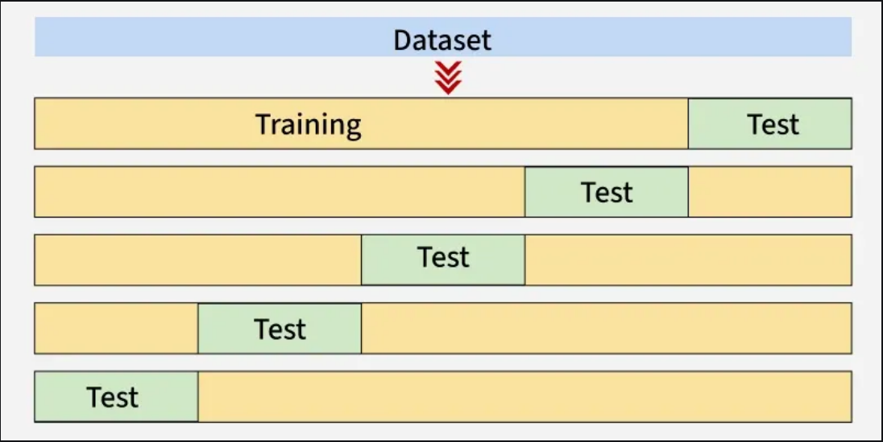
Cross Validation
Cross-validation is a resampling technique used to evaluate machine learning models by training and testing the model on different subsets of available data.

Slide 17
Objectives of Cross Validation
Objective of Cross Validation
To assess how the results of a statistical analysis will generalize to an independent data set.
Prevents Overfitting (where a model performs well on training data but poorly on new data) and Underfitting.
It ensures that every observation in the dataset has the chance to be used in both training and testing.
Ref: https://neptune.ai/blog/cross-validation-in-machine-learning-how-to-do-it-right

Slide 18
Types of Cross Validation
Hold-out
K-folds
Leave-one-out
Leave-p-out
Stratified K-folds
Repeated K-folds
Nested K-folds
Time series CV
Ref: https://neptune.ai/blog/cross-validation-in-machine-learning-how-to-do-it-right

Slide 19
Thank You

